Slide 1
MACHINE LEARNING
Session – 13
Date – 17th June, 2022

Slide 2

What is Regression?
The main goal of regression is the construction of an efficient model to predict the dependent attributes from a bunch of attribute variables. A regression problem is when the output variable is either real or a continuous value i.e salary, weight, area, etc.
We can also define regression as a statistical means that is used in applications like housing, investing, etc. It is used to predict the relationship between a dependent variable and a bunch of independent variables. Let us take a look at various types of regression techniques.

Slide 3
Types Of Regression
The following are types of regression.
Simple Linear Regression
Polynomial Regression
Support Vector Regression
Decision Tree Regression
Random Forest Regression

Slide 4
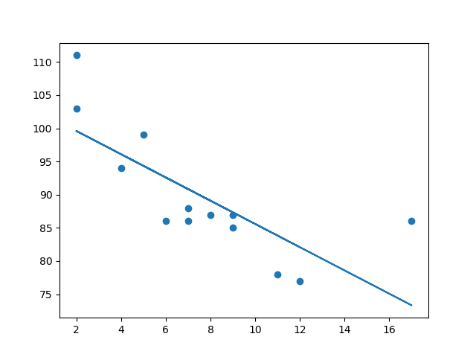
Linear Regression
Linear regression uses the relationship between the data-points to draw a straight line through all them.
This line can be used to predict future values.
Simple linear regression is a regression technique in which the independent variable has a linear relationship with the dependent variable. The straight line in the diagram is the best fit line. The main goal of the simple linear regression is to consider the given data points and plot the best fit line to fit the model in the best way possible.

Slide 5
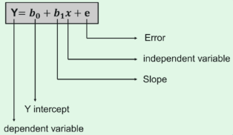
Cost Function
The best fit line can be based on the linear equation given below.
The dependent variable that is to be predicted is denoted by Y.
A line that touches the y-axis is denoted by the intercept b₀.
b₁ is the slope of the line, x represents the independent variables that determine the prediction of Y.
The error in the resultant prediction is denoted by e.
The cost function provides the best possible values for b₀ and b₁ to make the best fit line for the data points. We do it by converting this problem into a minimization problem to get the best values for b₀ and b₁. The error is minimized in this problem between the actual value and the predicted value.

Slide 6
Use Case – Implementing Linear Regression
The process takes place in the following steps:
Loading the Data
Exploring the Data
Slicing The Data
Train and Split Data
Generate The Model
Evaluate The accuracy

Slide 7
1. Loading The Data
from sklearn import datasets
disease = datasets.load_diabetes()
print(disease)
2. Exploring The Data
print(disease.keys())
The above code gives all the labels from the data set, after this, we can slice the data so that we can plot the line in the end. We will also use all the data points, for now, we will slice column 2 from the data.
import numpy as np
disease_X = disease.data[:, np.newaxis,2]
print(disease_X)

Slide 8
3. Splitting The Data
disease_X_train = disease_X[:-30]
disease_X_test = disease_X[-20:]
disease_Y_train = disease.target[:-30]
disease_Y_test = disease.target[-20:]
4. Generating the model
from sklearn import linear_model
reg = linear_model.LinearRegression()
reg.fit(disease_X_train,disease_Y_train)
y_predict = reg.predict(disease_X_test)

Slide 9
5. Evaluation
accuracy = mean_squared_error(disease_Y_test,y_predict,)
print(accuracy)
weights = reg.coef_
intercept = reg.intercept_
print(weights,intercept)
To be more clear on how the data points look like on the graph, let us plot the graphs as well.
import matplotlib.pyplot as plt
plt.scatter(disease_X_test, disease_Y_test)
plt.plot(disease_X_test,y_predict)
plt.show()

Slide 10
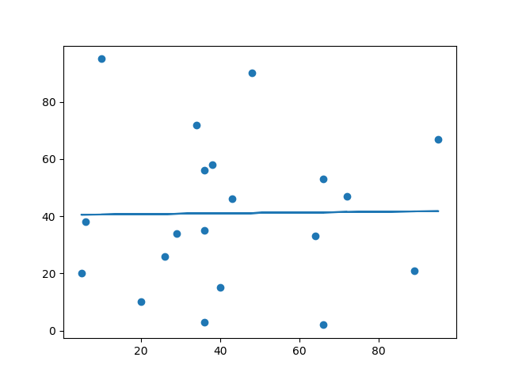
Bad Fit?
Let us create an example where linear regression would not be the best method to predict future values.
import matplotlib.pyplot as plt
from scipy import stats
x = [89,43,36,36,95,10,66,34,38,20,26,29,48,64,6,5,36,66,72,40]
y = [21,46,3,35,67,95,53,72,58,10,26,34,90,33,38,20,56,2,47,15]
slope, intercept, r, p, std_err = stats.linregress(x, y)
def myfunc(x):
return slope * x + intercept
mymodel = list(map(myfunc, x))
plt.scatter(x, y)
plt.plot(x, mymodel)
plt.show()

Slide 11
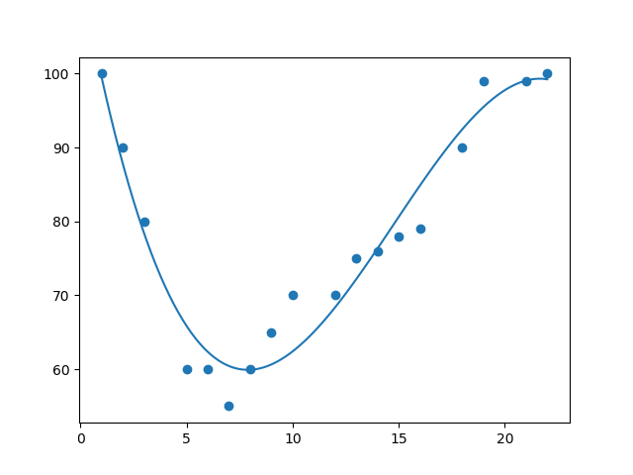
Polynomial Regression
If your data points clearly will not fit a linear regression (a straight line through all data points), it might be ideal for polynomial regression.
Polynomial regression, like linear regression, uses the relationship between the variables x and y to find the best way to draw a line through the data points.

Slide 12
Multiple Regression
Multiple regression is like linear regression, but with more than one independent value, meaning that we try to predict a value based on two or more variables.
Example –
We can predict the CO2 emission of a car based on the size of the engine, but with multiple regression we can throw in more variables, like the weight of the car, to make the prediction more accurate.

Slide 13
